Slide 1

SCSA1201 FUNDAMENTAL OF DIGITAL SYSTEMS
Unit – 4
SEQUENTIAL CIRCUITS

Slide 2
Syllabus
UNIT III SEQUENTIAL CIRCUITS
Introduction to Sequential circuits – Flip flops – SR, JK, D and T flip flops, Master Slave flip flop, Characteristic and excitation table – Realization of one flip flop with other flip flops – Registers – Shift registers – Counters – Synchronous and Asynchronous counters – Modulus counters – Ring Counter – Johnson Counter – State diagram, State table, State minimization – Hazards

Slide 3
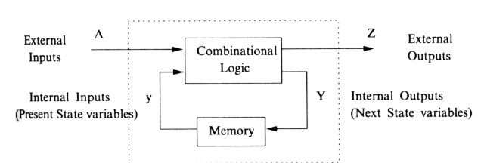
Sequential Circuits
The outputs of sequential circuit depends not only on the combination of present inputs but also on the previous outputs.

Slide 4
Types of Sequential Circuits
Asynchronous sequential circuits : In asynchronous sequential circuits change in input signals can affect memory element at any instant of time.
Synchronous sequential circuits : In Synchronous sequential circuits, signals can affect the memory elements only at discrete instants of time.

Slide 5

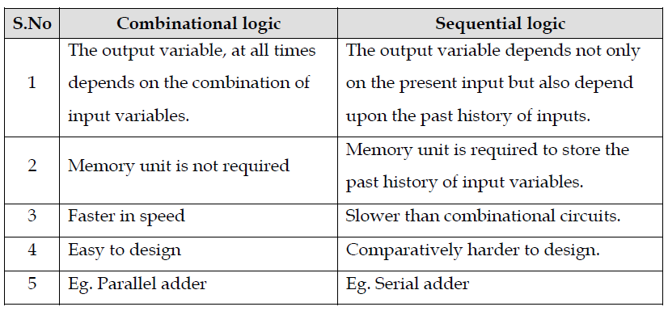
The Comparison Between Combinational and Sequential Circuits

Slide 6
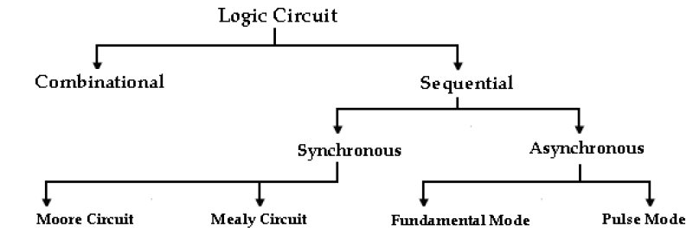
Classification of Logic Circuits

Slide 7
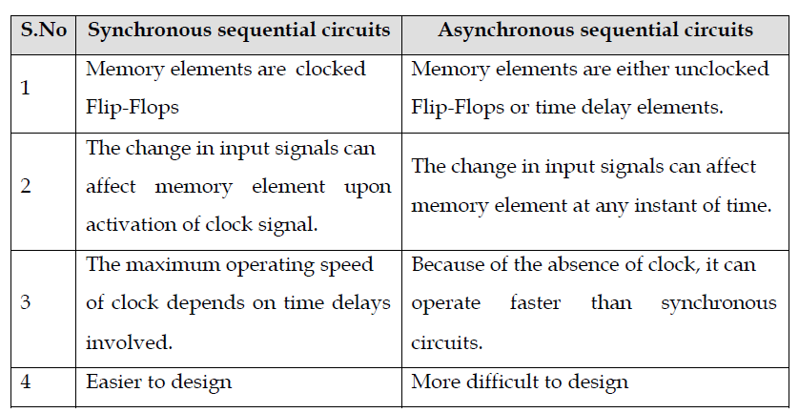
Comparison Between Synchronous and Asynchronous Sequential Circuits

Slide 8
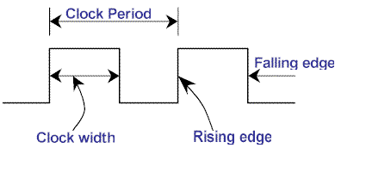
Clock Signal
A clock signal is a particular type of signal that oscillates between a high and a low state. It is produced by clock generator.
Types of Triggering
Level triggering
Edge triggering

Slide 9

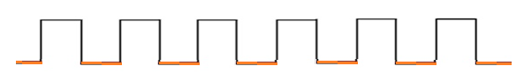
Level triggering
Positive level triggering- If the sequential circuit is operated with the clock signal when it is in Logic High, then that type of triggering is known as Positive level triggering
Negative level triggering- If the sequential circuit is operated with the clock signal when it is in Logic Low, then that type of triggering is known as Negative level triggering.

Slide 10
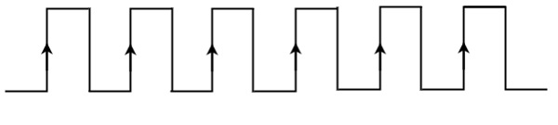
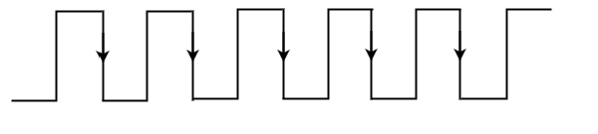
Edge triggering
Positive edge triggering - If the sequential circuit is operated with the clock signal that is transitioning from Logic Low to Logic High, then this is known as Positive edge triggering
Negative edge triggering - If the sequential circuit is operated with the clock signal that is transitioning from Logic High to Logic Low, then this is known as Negative edge triggering

Slide 11
LATCHES and FLIP FLOPS
A flip-flop or latch is a circuit that has two stable states and can be used to store one bit either 0 or 1.
The main difference between latches and flip-flops is that, latches operate with enable signal, which is level sensitive whereas, flip-flops are edge sensitive.
Types of flipflop
1.SR Flipflop
2.D Flipflop
3. JK Flipflop
4. T flipflop

Slide 12
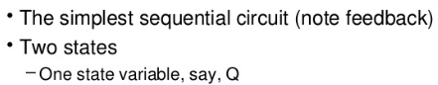
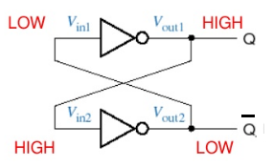
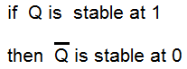
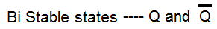
Bi-Stable Element

Slide 13

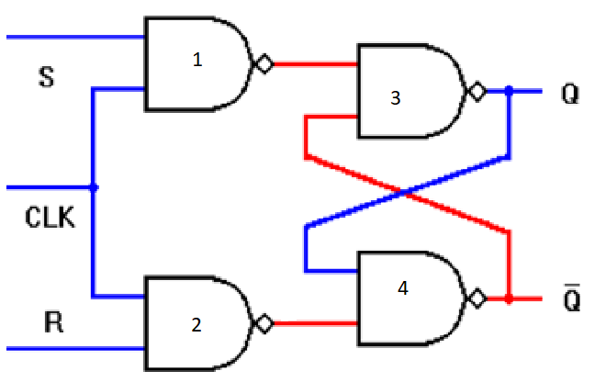
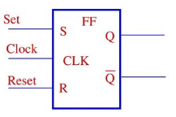
Clocked SR Flipflop (Set-Reset Flipflop)
Logic Symbol
Logic Diagram

Slide 14
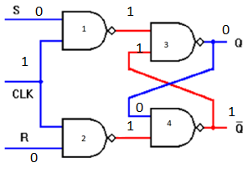
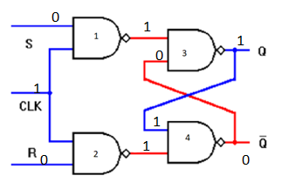
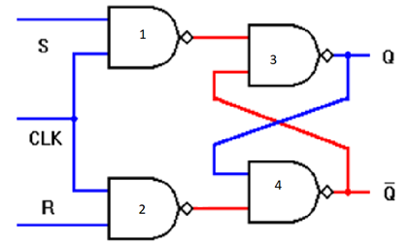
Clocked SR Flipflop Working
Case1: When S=R=0, clk=1,Qn=0,
Case1: When S=R=0, clk=1,Qn=1,
Qn+1=0 same as previous output
Qn+1=1 same as previous output

Slide 15
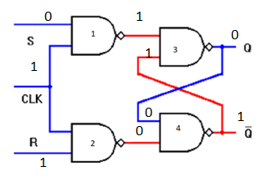
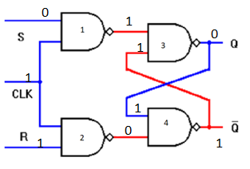
Clocked SR Flipflop Working Contd..
Case2: When S=0; R=1, clk=1, Qn=0,
Case 2: When S=0; R=1, clk=1, Qn=1
Qn+1= 0 Reset
Qn+1 = 0 Reset

Slide 16
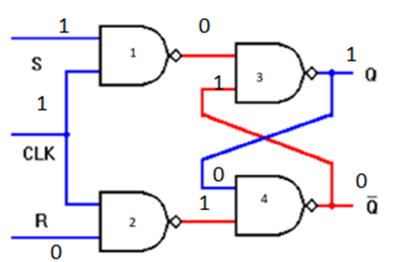
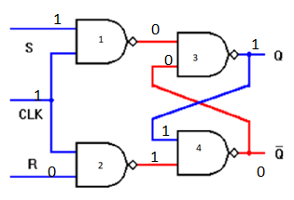
Clocked SR Flipflop Working Cont..
Case 3: When S=1; R=0, clk=1, Qn=0,
Case 3: When S=1; R=0, clk=1, Qn=1
Qn+1= 1 Set
Qn+1 = 1 Set

Slide 17
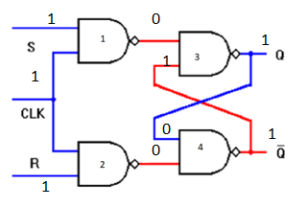
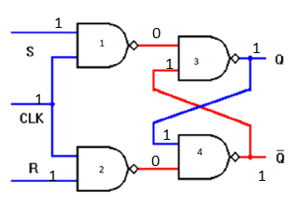
Clocked SR Flipflop Working Cont..
Case 4: When S=1; R=1, clk=1, Qn=0,
Case 4: When S=1; R=1, clk=1, Qn=1
Qn+1= 1 & Q’n+1 is also one which is an indeterminate state
Qn+1= 1 & Q’n+1 is also one which is an indeterminate state

Slide 18
Clocked SR Flipflop Working Contd..
Case 1: If S=R=0 and the clock pulse is applied, the output do not change, Q_{n+1 =} Q_{n}
Case 2: If S= 0, R=1 and the clock pulse is applied, Q_{n+1}= 0
Case 3: If S= 1, R=0 and the clock pulse is applied, Q_{n+1}= 1
Case4: If S= 1, R=1 and the clock pulse is applied, the state of the flipflop is undefined.

Slide 19
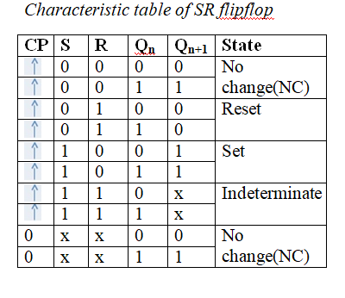
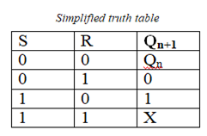
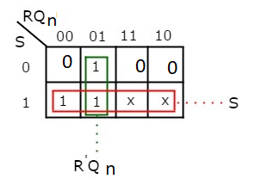
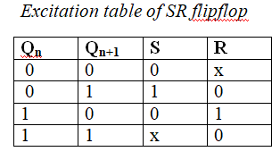
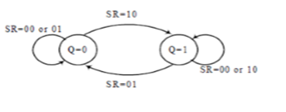
Clocked SR Flipflop Working Contd..
Characteristic Equation
Qn+1 = S+ R’Qn

Slide 20
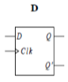
D Flipflop
The modified SR flipflop is known as delay flipflop (D Flipflop).
D input is connected to S input and complement of D input is connected to R input of SR flipflop.
Logic symbol

Slide 21
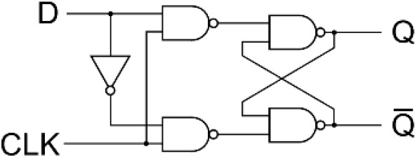
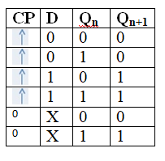
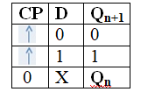
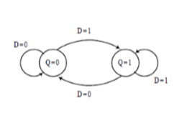
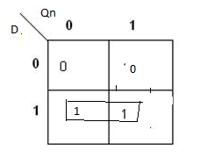
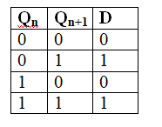
D Flipflop working cont…
( i) When D=1, S=1 and R=0 ; the output is set
(ii) When D=0, S=0 and R=1 ; the output is reset
Logic Diagram
Characteristic table
Characteristic Equation
State diagram
Excitation table
Qn+1 = D

Slide 22
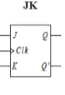
JK Flipflop
JK flipflop is also a modification of SR flipflop.
The uncertainity in the state of an SR flipflop when S=R=1 is being eliminated in JK flipflop.
Logic symbol

Slide 23
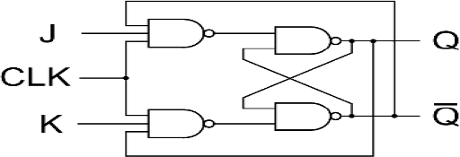
JK Flipflop working cont…
Logic Diagram
J input is ANDed with Q’ to obtain S input and K input is ANDed with Q to obtain R input.
Thus S= J.Q’ and R= K.Q.
Case 1: J=K=0
When J=K=0, S=R=0 and according to truth table of SR flipflop, output does not change. Hence,
when J=K=0; Q_{n+1}= Q_{n} (no output change)
Case 2: J=0 and K=1
Q=0, Q’=1 : When J=0 ,K=1 and Q=0; S=0 and R=0 then Q_{n+1}=0.
Q=1, Q’=0 : When J=0 ,K=1 and Q=1; S=0 and R=1 then Q_{n+1}=0.
Hence, when J=0 and K=1; Q_{n+1}= 0(Reset)
Case 3: J=1 and K=0
Q=0, Q’=1 : When J=1 ,K=0 and Q=0; S=1 and R=0 then Q_{n+1}=1.
Q=1, Q’=0 : When J=1 ,K=0 and Q=1; S=0 and R=0 then Q_{n+1}=1.
Hence, when J=1 and K=0 ; Q_{n+1}= 1 (Set)
Case 4: J=1 and K=1
Q=0, Q’=1 : When J=1 ,K=1 and Q=0; S=1 and R=0 then Q_{n+1}=1.
Q=1, Q’=0 : When J=1 ,K=1 and Q=1; S=0 and R=1 then Q_{n+1}=0
Hence, when J=1 and K=1 ; Q_{n+1}= Q_{n}’(Toggle)

Slide 24
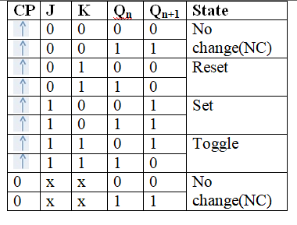
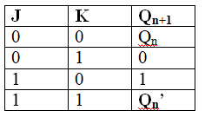
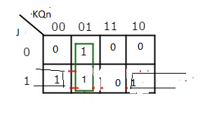
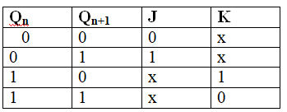
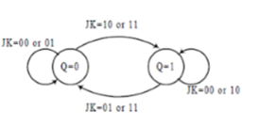
JK Flipflop working cont…
Characteristic table
Excitation table
Characteristic Equation
State diagram
Qn+1 = JQn’ +K’Qn

Slide 25
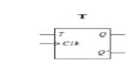
T Flipflop
T Flipflop is also known as toggle flipflop. It is a modification of JK flipflop
T Flipflop is obtained from a JK flipflop by connecting both inputs, J and K together
Logic symbol

Slide 26
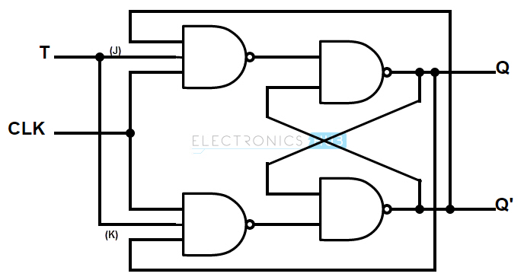
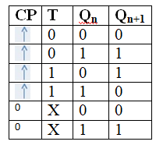
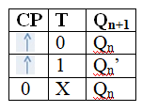
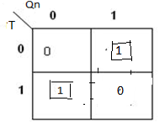
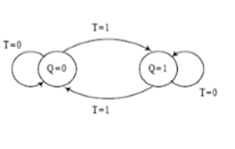
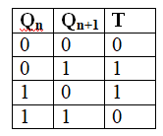
T Flipflop working contd…
When T=0, J=K=0 and hence
Q_{n+1}= Q_{n} (no output change)
(ii)When T=1, J=K=1 and hence Q_{n+1}= Q_{n}’ (toggles)
Logic Diagram
Characteristic table
Characteristic Equation
State diagram
Excitation table
Qn+1 = TQn’ +T’Qn

Slide 27
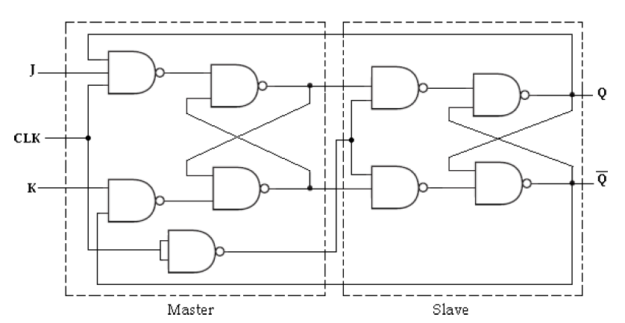

Master slave Flipflop
In master slave JK flip flop, it consists of clocked JK flipflop as a master and clocked SR flipflop as a slave.
The output of master flipflop is fed as an input to the slave flipflop.
Clock signal is directly connected to the master flipflop and it is connected through inverter to the slave flipflop
During the positive clock pulse, the information present at the J & K inputs is transmited to the output of master flipflop and it is held there until the negative clock pulse occurs.
After which it is allowed to pass through the output of slave flipflop.
Logic Diagram
Logic symbol

Slide 28

Master slave Flipflop
When J=0, K=0,output of master remains same at the positive clock and the output of slave also remains same at the negative clock.
When J=0, K=1,output of master resets at the positive clock and the output of slave also resets at the negative clock.
When J=1, K=0,output of master sets at the positive clock and the output of slave also sets at the negative clock.
When J=1, K=1,output of master toggles at the positive clock and the slave then copies the output of master at the negative clock. This prevents race around condition.
[In JK flip flop as long as clock is high for the input conditions J&K equals to the output changes or complements its output from 1–>0 and 0–>1.This is known as race around condition.]
Logic Diagram
Truth Table

Slide 29









Excitation Table or Application Table

Slide 30


Realization of One Flip - Flop using Other Flip - Flops

Slide 31





Slide 32





Slide 33




Slide 34





Slide 35





Slide 36





Slide 37





Slide 38
Excitation Table or Application Table

Slide 39
Registers
Registers are groups of flip-flops , where each flip-flop is capable of storing one bit of information. An n-bit register is a group of n flip-flops. The basic function of a register is to hold information in a digital system and make it available to the logic elements for the computing process.
A register consists of a collection of binary storage cells, each implemented by a flip-flop. The number of cells determines the length of the register and, therefore, the length of the binary word stored within the register.

Slide 40
Types of Registers in CPU
Accumulator ( Acc) : This is the most frequently used register used to store data taken from memory.
Memory Address Registers (MAR): It holds the address of the location to be accessed from memory.
Memory Data Registers (MDR): A register used for holding information (either program words or data words) that is in the process of being transferred from the memory to the central processor, or vice versa.
General Purpose Registers ( GPS) : The general purpose registers are used to store temporary data in the time of different operations in microprocessor.
Program Counter (PC): A program counter is a register in a computer processor that contains the address (location) of the instruction being executed at the current time.
Instruction Register (IR): In computing, the instruction register (IR) or current instruction register (CIR) is the part of a CPU's control unit that holds the instruction currently being executed or decoded.

Slide 41

Shift Registers
Shift Registers are used for data storage or for the movement of data and are therefore commonly used inside calculators or computers to store data such as two binary numbers before they are added together, or to convert the data from either a serial to parallel or parallel to serial format.

Slide 42


Shift Registers Cont..

Slide 43
Shift Registers cont..

Slide 44

Type of Shifting Operation in Shift Registers

Slide 45




Mode of operation in Shift Registers

Slide 46

Types of Shift Registers

Slide 47




Slide 48





Slide 49


Slide 50


Slide 51



Slide 52


Slide 53




Slide 54





Counters

Slide 55



Types of Counters

Slide 56

Comparison Between Asynchronous and Synchronous Counters

Slide 57




Slide 58




Cont..

Slide 59


Cont..

Slide 60


Cont..

Slide 61

Cont..
Cont..

Slide 62





Slide 63


Cont..

Slide 64


Slide 65





Slide 66

Cont..
Operation

Slide 67






Slide 68


Cont...
Operation

Slide 69






Slide 70



Slide 71





Slide 72




Slide 73
MOD ( Modulus) Counter
Flip-Flops can be connected together to perform counting operations. Such a group of Flip- Flops is a counter. The number of Flip-Flops used and the way in which they are connected determine the number of states (called the modulus) and also the specific sequence of states that the counter goes through during each complete cycle.

Slide 74





Slide 75

Design of Asynchronous MOD Counter
Procedure

Slide 76



Asynchronous BCD counter or MOD- 10 counter
Count from 0 – 9 ( 0000 – 1001)
From 10 – 15 ( 1010 – 1111) Reset

Slide 77



BCD counter or MOD- 10 counter

Slide 78



Design of Synchronous MOD Counter

Slide 79


Design of Synchronous MOD Counter Cont..
Step 4: Simplification using K - Map

Slide 80



Design of Synchronous MOD Counter Cont..
Step 5: Draw the Logic diagram

Slide 81



Ring Counter
Count = Number of flipflops
Used to identify the active state with Logic 1
6 – bit Ring Counter circuit Diagram
Truth Table
State Diagram

Slide 82


Johnson Counter
Count = Number of Flipflops * 2
Reduce the Number of Flipflops
Circuit Diagram
Truth Table

